Slide 1
Servlet

Slide 2
Servlet and its benefits
Servlets are modules of Java code that run in a server application (hence the name"Servlets", similar to "Applets" on the client side) to answer client requests.
Servlets are most commonly used with HTTP and the word "Servlet" is often used in the meaning of "HTTP Servlet".
Servlets make use of the Java standard extension classes in the packages
javax. servlet (the basic Servlet framework)
javax. servlet.http

Slide 3
Advantages
Performance is significantly better.
Only one copy of the servlet loaded into the JVM
Servlets execute within the address space of a Web server.
It is not necessary to create a separate process to handle each client request.
Servlets are platform-independent because they are written in Java.
Java security manager on the server enforces a set of restrictions to protect the resources on a server machine

Slide 4
Creation of Java Servet Class
Java Class must extend Httpservlet and overide Httpservlet’s doGet() or doPost() methods.
doGet() and doPost() methods require HttpservletRequest and HttpservletResponse object as argument .

Slide 5
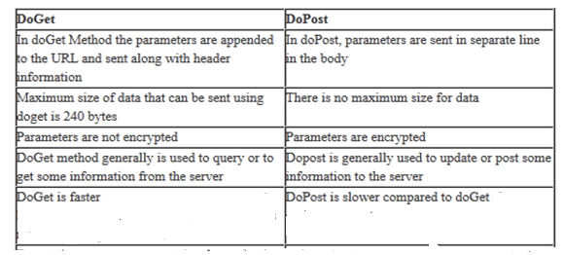
DoGet Vs DoPost

Slide 6
Simple Java Servlet
import java.io.*;
import javax.servlet.*;
import javax.servlet.http.* ;
public class HelloServlet extends Httpservlet {
public void doGet(HttpservletRequest request,
HttpservletResponse response)
throws ServletException, IOException {
response.setContentType("text/html");
PrintWriter out = response.getWriter();
out.println("<B>Hello!");
out.close();
}
}

Slide 7
Deployment Descriptor:
web.xml
<servlet>
<servlet-name>HelloServlet</servlet-name>
<servlet-class >HelloServlet </servlet-class>
</servlet>
<servlet-mapping>
<servlet-name>HelloServlet</servlet-name>
<url-pattern>/servlet/HelloServlet</url-pattern>
</servlet-mapping>

Slide 8
A Simple Servlet
http://localhost:8080/servlet/HelloServlet

Slide 9
A Simple Servlet:Running Procedure
Create and compile the servlet source code.
copy the servlet’s class file to proper directory
Add the servlet’s name and mappings to proper web.xml file
2. Start Tomcat.
3. Start a Web browser and request the servlet.

Slide 10
Using Tomcat For Servlet Development
1)The default location for Tomcat 4.0 is
C:\Program Files\Apache Tomcat 4.0\
2)Start Tomcat in the Start | Programs menu, or run startup.bat from the
C:\Program Files\Apache Tomcat 4.0\bin\ startup.bat
3)Stop Tomcat run shutdown.bat.
C:\Program Files\Apache Tomcat4.0\common\lib\ shutdown.bat.
4)JAR file contains the classes and interfaces that are needed to build servlets.
C:\Program Files\Apache Tomcat 4.0\common\lib\servlet.jar.
5)Must put the servlet files into the following directory:
C:\Program Files\Apache Tomcat 4.0\webapps\WEB-INF\classes\servlet.java
6) Must put the web.xml files into the following directory:
C:\Program Files\Apache Tomcat 4.0\webapps\WEB-INF\web.xml

Slide 11
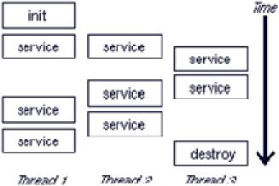
Anatomy of Java Servlet

Slide 12
The init() Method
Called by the Web container when the servlet instance is first created
The Servlets specification guarantees that no requests will be processed by this servlet until the init method has completed
Override the init() method when:
You need to create or open any servlet-specific resources that you need for processing user requests
You need to initialize the state of the servlet

Slide 13
The service() Method
Called by the Web container to process a user request
Dispatches the HTTP requests to doGet(…), doPost(…), etc. depending on the HTTP request method (GET, POST, and so on)
Sends the result as HTTP response
Usually we do not need to override this method

Slide 14
The destroy() Method
Called by the Web container when the servlet instance is being eliminated
The Servlet specification guarantees that all requests will be completely processed before this method is called
Override the destroy method when:
You need to release any servlet-specific resources that you had opened in the init() method
You need to persist the state of the servlet

Slide 15
1.Creates an instance of the servlet class
2. Invokes the service method, passing a request and response object.
3. If the container needs to remove the servlet, it finalizes the servlet by calling the servlet’s destroy method.

Slide 16
Reading data from a client
GET and POST methods are used to pass information from a form to a Java Servlet.
While using GET method the form data is passed in the url as query parameters.
GET method is the default method used. It looks like,
http://www.test.com/hello?key1 = value1&key2 = value2
Never use the GET method if you have password or other sensitive information to pass to the server.
The GET method has size limitation: only 1024 characters can be used in a request string.

Slide 17
POST Method
A generally more reliable method of passing information to a backend program is the POST method.
This posts the information in exactly the same way as GET method, but instead of sending it in the URL it sends as a separate message.
This message comes to the backend program in the form of the standard input which you can parse and use for your processing.
Servlet handles this type of requests using doPost() method.
Data parsing is done automatically using the following methods-
getParameter() − to get the value of a form parameter.
getParameterValues() − for multiple values, for example checkbox.
getParameterNames() − list of all parameters in the current request.

Slide 18
Here is a simple URL which will pass two values to HelloForm program using GET method.
http://localhost:8080/HelloForm?class_name = 5th C subject = AJP.
One can write servlet program to handle input given by web browser.
We need to use getParameter() method which makes it which makes it very easy to access passed information.

Slide 19
Reading HTTP Request Headers
HTTP header fields are components of the header section of request and response messages in the Hypertext Transfer Protocol (HTTP).
They define the operating parameters of an HTTP transaction.
When an HTTP client (e.g. a browser) sends a request, it is required to supply a request line (usually GET or POST).
If it wants to, it can also send a number of headers, all of which are optional except for Content-Length, which is required only for POST requests.

Slide 20
Http Request Headers

Slide 22
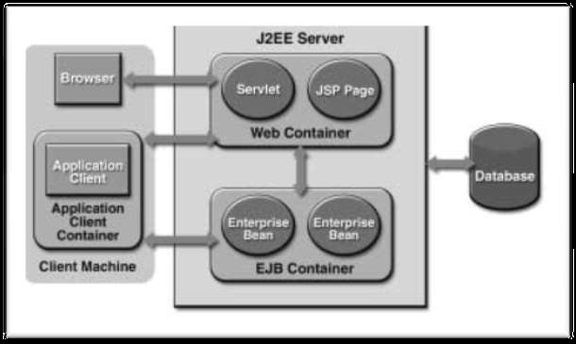

Slide 23
Sending Data to Client
Respond to client request by reading cient data
Http Request header process the information based on nature of request
There are two ways to respond to client request
(i)sending information to response stream:creating instance of PrintWriter class
(ii)sending response in HTTP response header:Status line ,response header
Java servlet write to HTTP response header by calling setStatus() method of HttpserveletResponse object
Response.setStatus(100);

Slide 24
Sending Data to Client:Http Response
Sending data to a client

Slide 26
Http Response status code

Slide 28
Write Servlet to display first name and Last name of the User.
Get the values through html form from the user .
Pass these values to servlet and display.

Slide 29
<htm l>
<body>
<form name="Form1“ method=“get"
action ="/servlet/HelloForm”>
First Name: <input type="text" name="first_nam e">
Last Name: <input type="text" name="last_nam e" />
<input type="submit" value="Submit" />
</form >
</body>
</htm l>

Slide 30
Deployment Descriptor
web.xml
<servlet>
<servlet-name> HelloForm </servlet-name>
<servlet-class > HelloForm </servlet-class>
</servlet>
<servlet-mapping>
<servlet-name> HelloForm </servlet-name>
<url-pattern>/servlet/ HelloForm </url-pattern>
</servlet-mapping>

Slide 31
// Import required java libraries
import java.io.* ;
import javax.servlet.* ;
import javax.servlet.http.* ;
// Extend HttpServlet class
public class HelloForm extends HttpServlet {
// Method to handle GET m ethod request.
public void doGet(HttpServletRequest request,
HttpServletResponse response)
throws ServletException, IOException
{
// Set response content type
response.setContentType("text/htm l");
PrintWriter out = response.getWriter();

Slide 32
out.println("<html>");
out.println("<body>");
Firstname=request.getParameter("first_nam e") ; Last Name=request.getParameter("last_nam e”);
out.println(“<b>As per the entry , your first and last name is</b>”+Firstname+’ ‘+LastName);
out.println("</body>");
out.println("</html>");
out.close();
}
}

Slide 33
Write Servlet Program to display the selected color of the user.
Get the values through html drop down form .
Pass these values to servlet and display.

Slide 34
<html>
<body>
<center>
<form name="Form1"
method="post"
action="/servlet/ColorPostServlet">
<B>Color:</B>
<select name="color" size="1">
<option value="Red">Red</option>
<option value="Green">Green</option>
<option value="Blue">Blue</option>
</select>
<input type=submit value="Submit">
</form>
</body>
</html>

Slide 35
Deployment Descriptor
web.xml
<servlet>
<servlet-name> ColorPostServlet </servlet-name>
<servlet-class > ColorPostServlet </servlet-class>
</servlet>
<servlet-mapping>
<servlet-name> ColorPostServlet </servlet-name>
<url-pattern>/servlet/ ColorPostServlet </url-pattern>
</servlet-mapping>

Slide 36
import java.io.*;
import javax.servlet.*;
import javax.servlet.http.*;
public class ColorPostServlet extends HttpServlet {
public void doPost(HttpServletRequest request,
HttpServletResponse response)
throws ServletException, IOException {
String color = request.getParameter("color");
response.setContentType("text/html");
PrintWriter out = response.getWriter();
out.println("<B>The selected color is: ");
out.println(color);
out.close();
}
}

Slide 37
http://localhost:8080 /servlet/ ColorPostServlet

Slide 38
Write Servlet Program to display the habits of the user from check boxes.
Get the values through html checkboxes .
Pass these values to servlet and display.

Slide 39
<html>
<body>
<form name="Form1"
method="post"
action="/servlet/HabitServlet">
Habits :
<input type="checkbox" name="habits" value="Reading">Reading
<input type="checkbox" name="habits" value="Movies">Movies
<input type="checkbox" name="habits" value="Writing">Writing
<input type="checkbox" name="habits" value="Singing">Singing
<input type="submit" value="Submit">
</form>
</body>
</html>

Slide 40
Deployment Descriptor
web.xml
<servlet>
<servlet-name> HabitServlet </servlet-name>
<servlet-class> HabitServlet </servlet-class>
</servlet>
<servlet-mapping>
<servlet-name> HabitServlet </servlet-name>
<url-pattern > /servlet/HabitServlet </url-pattern>
</servlet-mapping>

Slide 41
import javax.servlet.ServletException;
import javax.servlet.http.HttpServlet;
import javax.servlet.http.HttpServletRequest;
import javax.servlet.http.HttpServletResponse;
public class HabitServlet extends HttpServlet
{
public void doPost(HttpServletRequest req,HttpServletResponse res)throws ServletException,IOException
{
PrintWriter out=res.getWriter();
res.setContentType("text/html");
String[] values=req.getParameterValues("habits");
out.println("Selected Values...");
for(int i=0;i<values.length;i++)
{
out.println("<li>"+values[i]+"</li>");
}
out.close();
}
}

Slide 42
Write Servlet Program for login page.
Get the username and password through html .
Validate these in servlet and display appropriate results.

Slide 43
<html>
<head>
<title>login form</title>
</head>
<body>
<form name="Form1"
method="post"
action="/servlet/LoginHandler">
Name:<input type="text" name=“name" >
Password:<input type=“password" name="passwd" >
<input type="submit" value="login" > </form> </body>
</html>

Slide 44
import java.io.*;
import java.util.*;
import javax.servlet.*;
import javax.servlet.http.*;
public class LoginHandler extends HttpServlet {
public void doPost(HttpServletRequest req, HttpServletResponse res)
throws ServletException, IOException {
res.setContentType("text/html");
PrintWriter out = res.getWriter();
// Get the user's name and password
String uname = req.getParameter("name");
String passwd = req.getParameter("passwd");
String nme="NMAMIT";
String pwd="NMAMIT12345";
out.println("<html>");
out.println("<body>");

Slide 45
// Check the name and password for validity
if (uname.equals(nme) && passwd.equals(pwd))
{
out.println("<h1>Hello!!Welcome to NMAMIT!!!!!!!</h1>");
}
else
{
out.println("<h1>Your username or password are invalid.</h1>");
out.println("You may want to <A HREF=\"/login.html\">try again</A>");
}
out.println("</body>");
out.println("</html>");
out.close();
}
}

Slide 46
web.xml
<servlet>
<servlet-name> LoginHandler </servlet-name>
<servlet-class> LoginHandler </servlet-class>
</servlet>
<servlet-mapping>
<servlet-name> LoginHandler </servlet-name>
<url-pattern > /servlet/ LoginHandler </url-pattern>
</servlet-mapping>

Slide 47
Working with Cookies
A cookie is a small amount of data that is saved on the client’s machine
Cookie can be created by and referenced by a Java servlet
(using the Java servlet cookie API)
A cookie is composed of two pieces.
cookie name and the cookie value,
both of which are created by the Java servlet.
The cookie name is used to identify a particular cookie from among other cookies stored at the client.
The cookie value is data associated with the cookie. Any character can be used except the following: [] () =," / ? @:;..

Slide 48
Working with Cookies
A Java servlet writes a cookie by passing the constructor of the Cookie object with two arguments.
The first argument is a String object that contains the name of the cookie.
The other argument is a String object that contains the value of the cookie.
The following statement illustrates how a cookie is created
Cookie myCookie = new Cookie ("userID", “123");
The Java servlet must then insert the cookie into the HTTP response header by calling the addCookie() method of the HttpservletResponse object.
The addCookie() method requires one argument.
The addCookie() method must be called before the Java servlet writes the response document.

Slide 49
To add a cookie to the HTTP response header.
response .addCookie (myCookie) ;
To read a cookie by call the getCookies() method of the HttpservletRequestobject.
The getCookies() method returns an array of Cookie objects.
The Java servlet can then step through the array of Cookie objects and retrieve attributes of each cookie by calling the getXXX() method,
where XXX represent the name of the attribute that you want to retrieve.

Slide 51
addCookie():Append new cookie to existing cookies.
(Max size is 2 MB)
setValue():Modify the attribute value of the cookie.
getCookies( ) :to read the cookies
Adding the cookie to Http response header:
response.addCookie(myCookie);

Slide 52
Illustrate with servlet program creation of the cookies .Also display name and values the of cookie.

Slide 53
<html>
<body>
<center>
<form name="Form1"
method="post"
action="/servlet/AddCookieServlet">
<B>Enter a value for MyCookie:</B>
<input type=textbox name="data" size=25 value="">
<input type=submit value="Submit">
</form>
</body>
</html>

Slide 54
import java.io.*;
import javax.servlet.*;
import javax.servlet.http.*;
public class AddCookieServlet extends HttpServlet {
public void doPost(HttpServletRequest request,HttpServletResponse response)
throws ServletException, IOException {
// Get parameter from HTTP request.
String data = request.getParameter("data");
// Write output to browser.
response.setContentType("text/html");
PrintWriter out = response.getWriter();
out.println("<B>MyCookie has been set to");
out.println(data);
// Create cookie.object
Cookie cookie = new Cookie("MyCookie", data);
// Add this to HTTP response.
response.addCookie(cookie);
out.close();
}
}

Slide 55
import java.io.*;
import javax.servlet.*;
import javax.servlet.http.*;
public class GetCookiesServlet extends HttpServlet {
public void doGet(HttpServletRequest request,
HttpServletResponse response)
throws ServletException, IOException {
// Get cookies from header of HTTP request.
Cookie[] cookies = request.getCookies();
// Display these cookies.
response.setContentType("text/html");
PrintWriter out = response.getWriter();
out.println("<B>");
for(int i = 0; i < cookies.length; i++) {
String name = cookies[i].getName();
String value = cookies[i].getValue();
out.println("name = " + name +"; value = " + value);
}
out.close();
}
}

Slide 56
Tracking Sessions
A session is created each time a client requests service from a Java servlet.
The Java servlet processes the request and responds accordingly, after which the session is terminated.
Many times the same client follows with another request to the same Java servlet, and the Java servlet requires information regarding the previous session to process the current request.
However, HTTP is a stateless protocol, meaning that there isn’t any holdover from previous sessions.
Therefore, there is no way to track sessions using HTTP.
A Java servlet is capable of tracking sessions by using the HttpSession API.
The HttpSession API uses the HttpSession object that is associated with the HttpservletRequest to determine if the request is a continuation from an existing session or is a new session.

Slide 57
A Java servlet calls the getSession() method of the HittpservietRequest object, which returns an HttpSession object if it is a new session.
The getSession() method requires one argument, which is a boolean true.
The following statement illustrates how this is written:
If the getSession() method doesn’t use an argument, then the getSession() method returns either the existing session or the getSession() method creates a new session and returns the session object.
If the getSession() method takes a boolean true as an argument, the getSession() method returns the current session as a session object.
If the current session doesn’t exist, the getSession() method creates a new session and returns a session object.
If the current session doesn’t exist, the getSession() method returns a null.
HttpSession sl = request.getSession(true);

Slide 58
Write servlet program to Display date/time of last access and also display current date/time.

Slide 59
import java.io.*;
import java.util.*;
import javax.servlet.*;
import javax.servlet.http.*;
public class DateServlet extends HttpServlet {
public void doGet(HttpServletRequest request,
HttpServletResponse response)
throws ServletException, IOException {
// Get the HttpSession object.
HttpSession hs = request.getSession(true);
// Get writer.
response.setContentType("text/html");
PrintWriter pw = response.getWriter();
pw.print("<B>");
// Display date/time of last access.
Date date = (Date)hs.getAttribute("date");
if(date != null) {
pw.print("Last access: " + date + "<br>");
}
// Display current date/time.
date = new Date();
hs.setAttribute("date", date);
pw.println("Current date: " + date);
}
}

Slide 60
JSP Introduction
Server side program similar in design and functionality to Java servlet.
Written in HTML rather java programming language.
Converted to a java servlet when client request the jsp.
However, a JSP offers basically the same features found in a Java servlet and JSP is converted to a Java servelet the first time that a client requests the JSP.

Slide 61
Lifecycle
jspInt()
service()
jspDestroy()

Slide 62
There are three methods that are automatically called when a JSP is requested and when the JSP terminates normally.
The jspInt() method, the ispDestroy() method, and the service() method. Also known as life-cycle methods of JSP.
The jspInt() method is identical the init() method in a Java servlet.
The jspInt() method is called first when the JSP is requested and is used to initialize objects and variables that are used throughout the life of the JSP. The jspDestroy() method is identical to the destroy() method in a Java servlet.
The destroy() method is automatically called when the JSP terminates normally.

Slide 63
The destroy() method is used for cleanup where resources used during the execution of the JSP are released, such as disconnecting from a database.
The service() method is automatically called and retrieves a connection to HTTP and never overridden.
Destroy isn‘t called if the JSP abruptly terminates like when the server crashes.

Slide 64
JSP Tags
JSP program consist of HTML and JSP tags.
JSP tag consist of java code to be executed before output sent to the browser.
Tags are processed by jsp virtual engine

Slide 65
Jsp tags
Comment tag
<%-- --%>
Ex:<%-- Jsp comment --%>
Declaration statement tags:To define variable,object and method
<%! %>
Ex:<%! int i=0 ;%>
Directive tags:To import java packages or file.
<%@ %>
Ex:<%@ page import=“import java.sql.*”; %>
<%@ include file=“keogh\books.html”%>

Slide 66
JSP tags
Expression tag:Used for an expression statement whose result replaces the expression tag.
<%= %>
Scriptlet tags: Commonly used for control and loop statement.
<% %>

Slide 67
Request String
<%! String Firstname =request.getParameter(fname);
String Lastname =request.getParameter(lname);%>

Slide 68
Write JSP program to illustrate the use of , declaration and expression tag

Slide 69
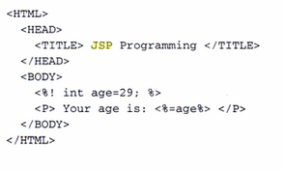

Slide 70
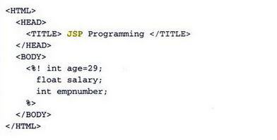

Slide 71
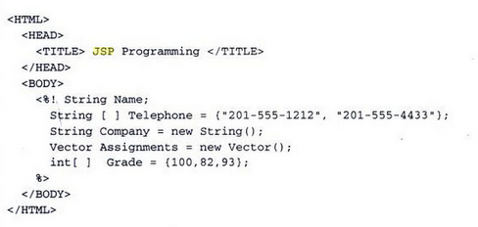

Slide 72
Write JSP program to illustrate writing methods and displaying its outcome.

Slide 73
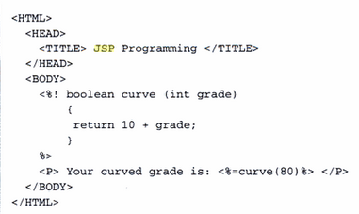
Methods

Slide 74
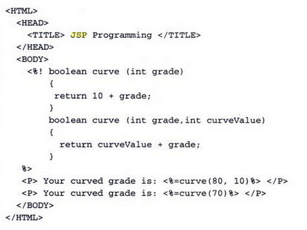

Slide 75
Control Statements
One of the most powerful features available in JSP is the ability to change the flow of the program to truly create dynamic content for a web page based on conditions received from the browser.
There are two control statements used to change the flow of a JSP program. These are the if statement and the switch statement.

Slide 76
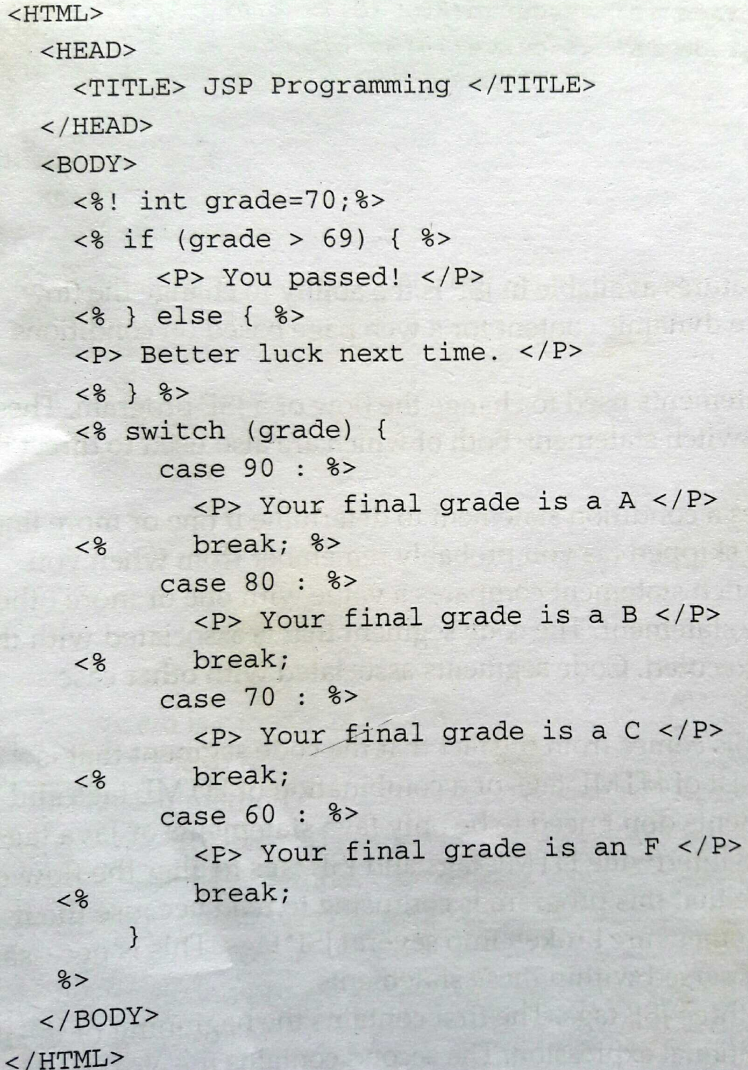

Slide 77
Loops in JSP
JSP loops are almost identical to loops that used in Java program except JSP can repeat HTML tags and related information multiple times within the JSP program without having to enter the additional HTML tags.
Three kinds of loops commonly used in a JSP program. These are the for loop the while loop, and the do...while loop.
The for loop repeats, usually a specified number of times.
The while loop executes continually as long as a specified condition remains true. The while loop may not execute because the condition may never be true.
In contrast, the do...while loop executes at least once; afterwards, the conditional expression determine if the loop should be executed another time.

Slide 78
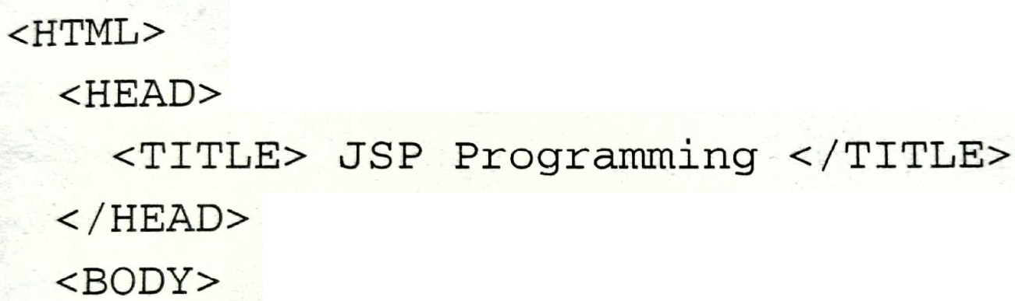
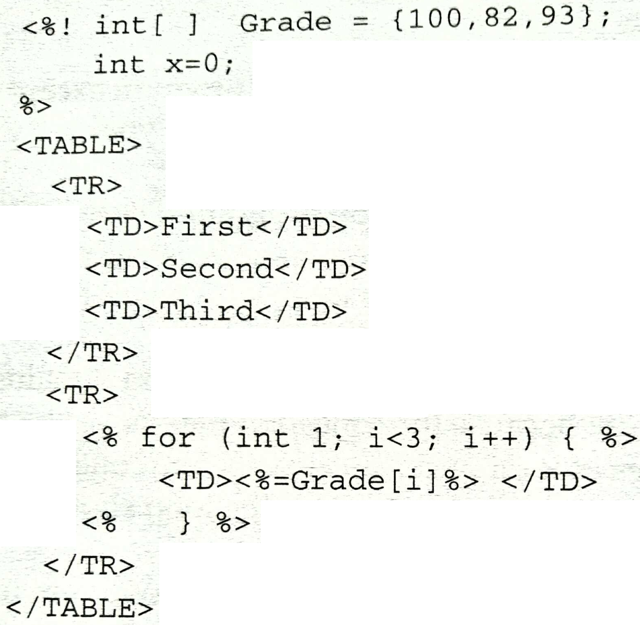

Slide 79
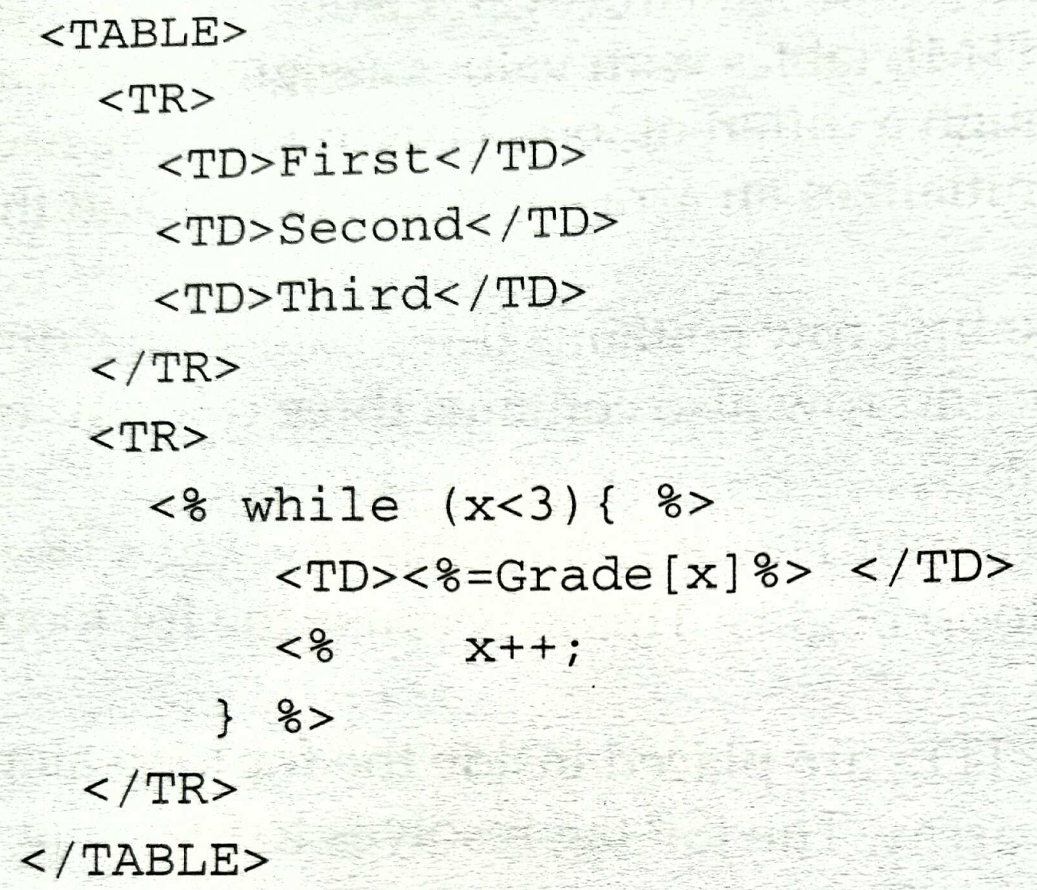

Slide 80
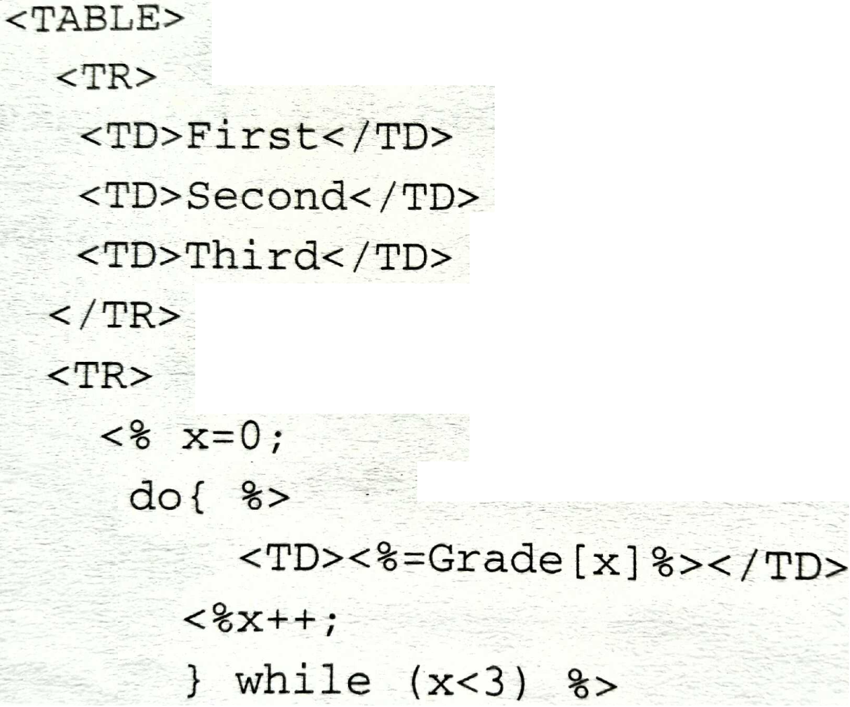
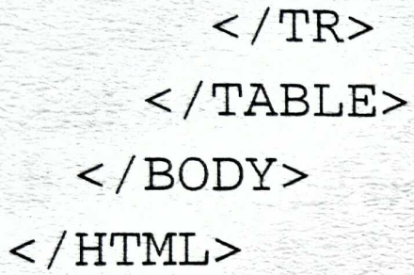

Slide 81
Form handling (or Form Processing) in JSP
Forms are the basic components that help us interact with web pages.
The form processing became very easy with the help of JSP.
The browser uses GET method and POST method for passing the information to the web server.
GET Method
The GET method is used to send the encoded user information appended to the page URL. Each encoded information is separated by '?' character.
GET is a default method to send information to web server. We should avoid using GET method to send sensitive information like as password etc. The GET method has only 4 bytes characters.
For example: http://www.tutorialride.com/hello?key1=value1&key2=value2

Slide 82
Example : Implementing GET method using Form
//welcome.html < html> <head> <title>Using POST method</title> </head> < body>
<h2>Using GET method</h2> <form action = "welcome.jsp" method = "POST">
Name: <input type = "text“ name = "name"/>
City: <input type = "text" name = "city"/>
Job: <input type = "text" name = "job“/>
<input type = "submit" value = "Submit"> </form> < /body> < /html>

Slide 83
GET Method Example
<html> <head> <title>Reading data by Using GET method</title> </head> < body> <h1>GET method</h1> <b>Name:</b> <%= request.getParameter("name")%> <b>City:</b> <%= request.getParameter("city")%> <b>Profession:</b> <%= request.getParameter(“job")%> < /body> < /html>

Slide 84
POST Method
The POST method is used to send large amount of data on web server.
When we want to send any sensitive data on web page, the POST method should be used (instead of sending text string in URL).
It sends the encrypted message.
Data parsing is done automatically using the following methods-
getParameter() − to get the value of a form parameter.
getParameterValues() − for multiple values, for example checkbox.
getParameterNames() − list of all parameters in the current request.

Slide 85
Example : Implementing POST method using Form
//welcome.html < html> <head> <title>Using POST method</title> </head> < body>
<h2>Using POST method</h2> <form action = "welcome.jsp" method = "POST">
Name: <input type = "text“ name = "name"/>
City: <input type = "text" name = "city"/>
Job: <input type = "text" name = "job“/>
<input type = "submit" value = "Submit"> </form> < /body> < /html>

Slide 86
//welcome.jsp < html> <head> <title>JSP page using POST method</title> </head>
< body>
Name: <%= request.getParameter ("name") %>
City: <%= request.getParameter ("city") %>
Job: <%= request.getParameter ("job") %> < /body> < /html>

Slide 87
Wite JSP Program to display first Name and Last Name of User.

Slide 88
<%@ page language="java" contentType="text/html"%>
<html>
<body>
<form action="result.jsp" method="GET">
First Name: <input type="text" name="firstname"> <br>
Last Name: <input type="text" name="lastname" /> <input type="submit"
value="Submit" />
</form>
</body>
</html>

Slide 89
<%@ page language="java" contentType="text/html;"%>
<html>
<head>
<title>Using GET and POST Method to Read Form Data</title>
</head>
<body>
<h1>As per your entry </h1>
<b>First Name:</b>
<%=request.getParameter("firstname")%>
<b>Last Name:</b>
<%=request.getParameter("lastname")%>
</p></li>
</ul>

Slide 90
Wite JSP Program to display Author info

Slide 91
<html>
<head>
<title>Echoing HTML Request Parameters</title>
</head>
<body>
<h3>Choose an author:</h3>
<form method="get">
<input type="checkbox" name="author" value=“Herbert"> Herbert
<input type="checkbox" name="author" value=“Navathe"> Navathe
<input type="checkbox" name="author" value=“Peterson"> Peterson
<input type="submit" value="Query">
</form>

Slide 92
<% String[] authors = request.getParameterValues("author");
if (authors != null) {
%>
<h3>You have selected author(s):</h3>
<% for (int i = 0; i < authors.length; ++i) {
%>
<p><%= authors[i] %></p>
<%
} %>
<a href="<%= request.getRequestURI() %>">BACK</a>
<% } %>
</body>
</html>

Slide 93
User Sessions (JSP)
A JSP program must be able to track a session as a client moves between HTML pages and ISP programs
There are three commonly used methods to track a session.
These are by using a hidden field, by using a cookie, or by using a JavaBean.
A hidden field is a field in an HMI form whose value isn’t displayed on the HTML page.
Eg: <input type = “hidden“ name = “abc“ value=123 />

Slide 94
Cookies
A cookie is a small piece of information created by a JSP program that is stored on the client's hard disk by the browser.
Cookies are used to store various kinds of information, such as user preferences and an ID that tracks a session with a JSP database system.
You can create and read a cookie by using methods of the Cookie class and the response object as illustrated.

Slide 95
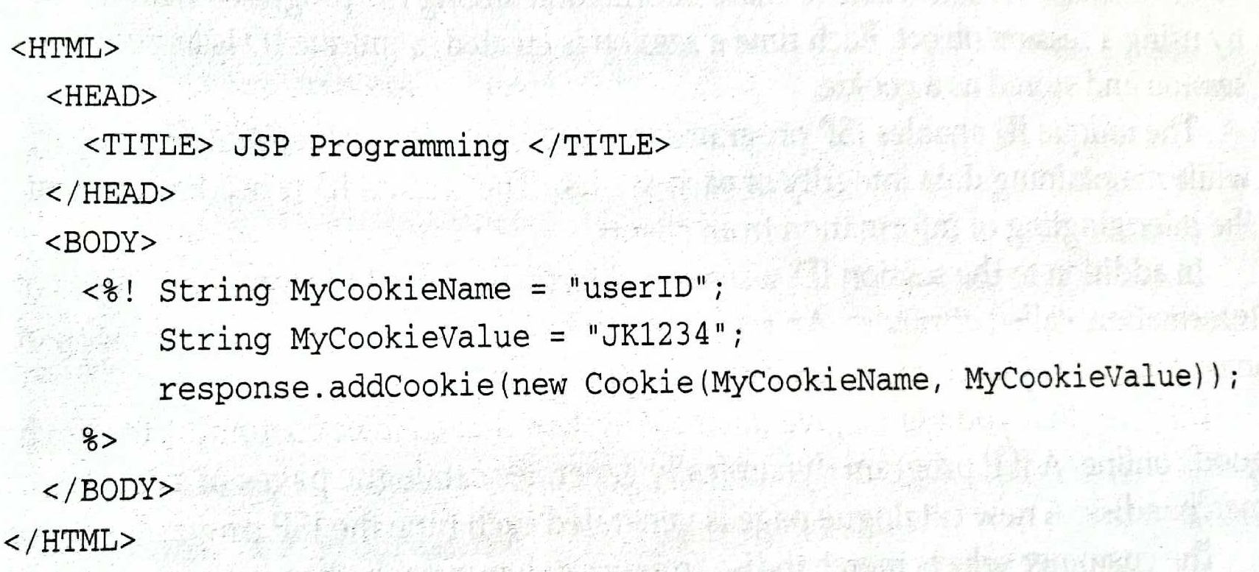
Above listing creates and writes a cookie called userID that has a value of JK1234.
The program begins by initializing the cookie name and cookie value and then passes these String objects as arguments to the constructor of a new cookie.
This cookie is then passed to the addCookie() method, which causes the cookie to be written to the client’s hard disk.

Slide 96
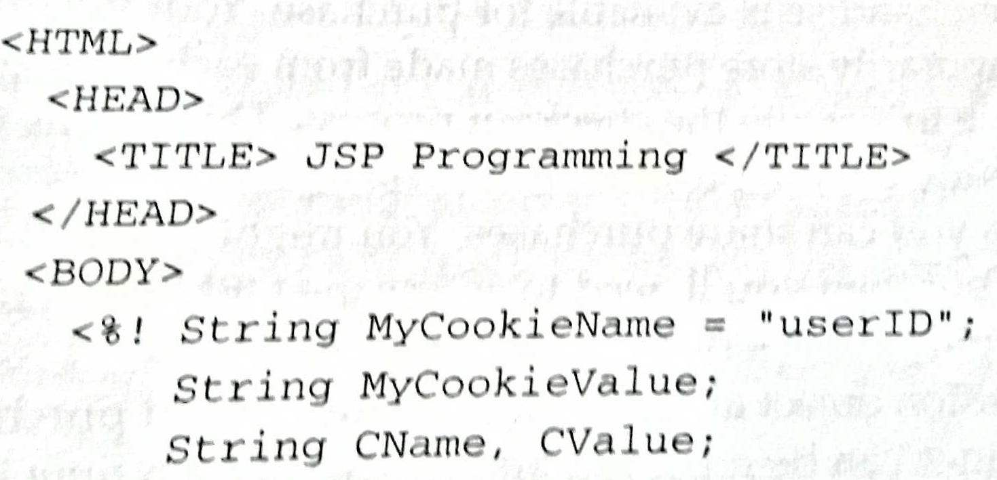
To read a cookie

Slide 97
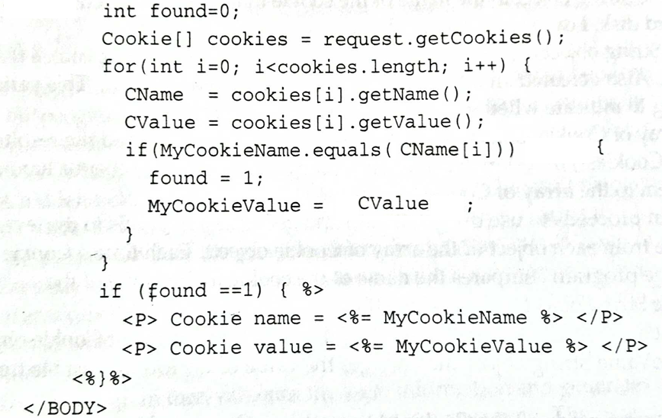

Slide 98
The above listing retrieves a cookie and sends the cookie name and cookie value to the browser, which displays these on the screen.
This program begins by initializing the MyCookieName String object to the name of the cookie that needs to be retrieved from the client's hard disk.
Two other String objects are created to hold the name and value of the cookie read from the client.
Also an int called found and initialized it to zero. This variable is used as a flag to indicate whether or not the userlID cookie is read.
Next, an array of Cookie objects called cookies is created and assigned the results of the request.getCookies() method, which reads all the cookies from the client's hard disk and assigns them to the array of Cookie objects.
The program proceeds to use the getName() and getValue() methods to retrieve the name and value from each object of the array of Cookie objects.

Slide 99
Session objects.
A JSP database system is able to share information among JSP programs within a session by using a session object.
Each time a session is created, a unique ID is assigned to the session and stored as a cookie.
The unique ID enables JSP programs to track multiple sessions simultaneously while maintaining data integrity of each session.
The session ID is used to prevent the intermingling of information from clients.
In addition to the session ID, a session object is also used to store other types of information, called attributes.
An attribute can be login information, preferences, or even purchases placed in an electronic shopping cart.

Slide 100
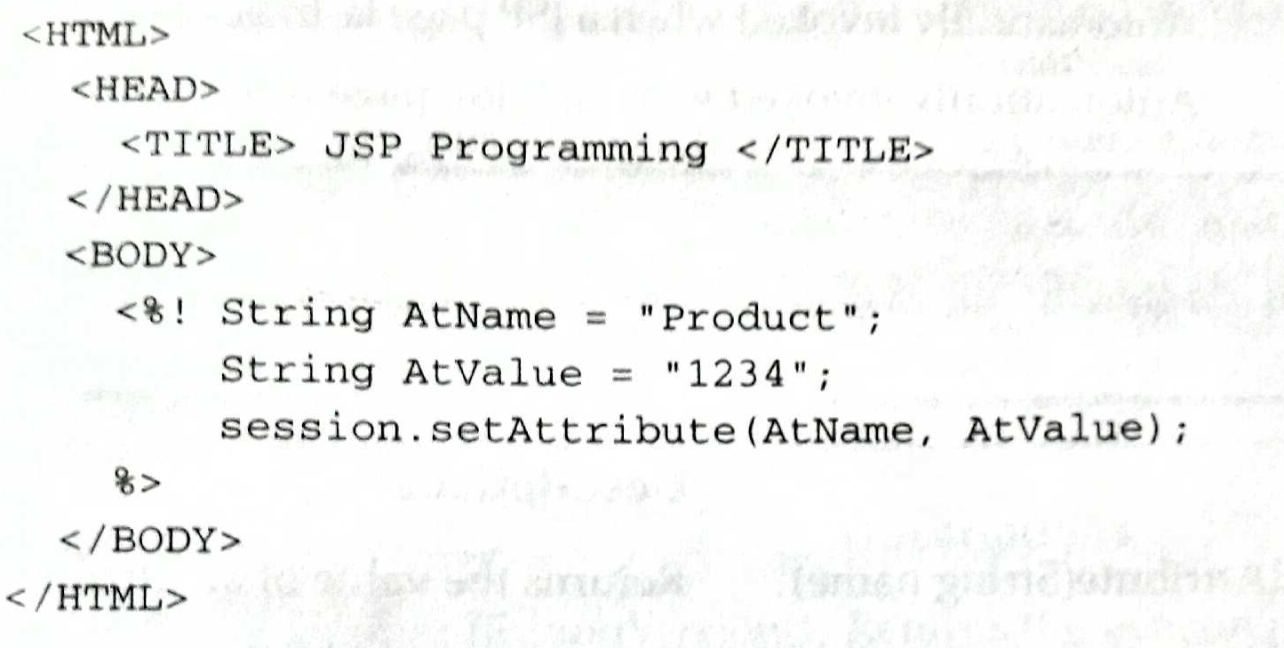
Following shows how to create a session attribute
In this example, the program creates and initializes two String objects.
One String object is assigned the name of the attribute and the other String object is assigned a value for the attribute.
Next, the program calls the setAttribute() method and passes this method the name and value of the attribute.

Slide 101
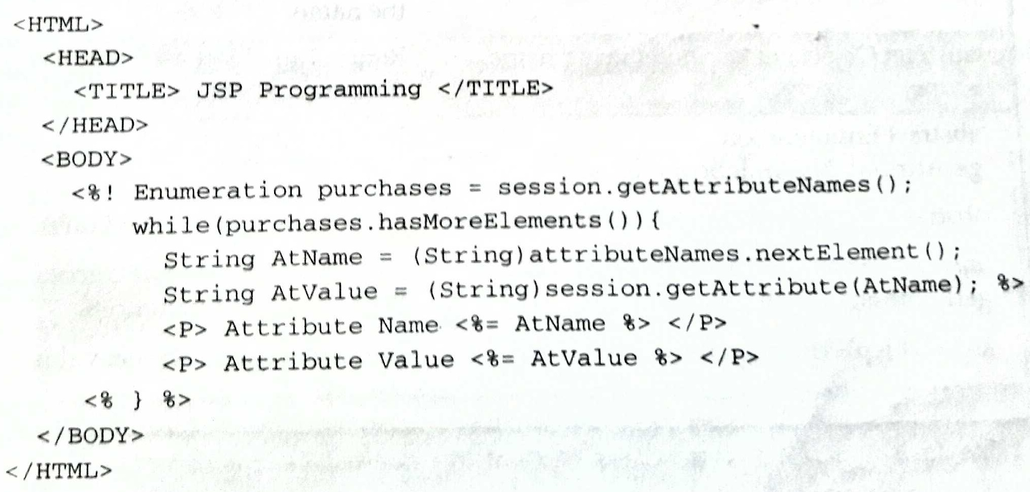
Following shows how to read a session attribute.

Slide 102
The program begins by calling the getAttributeNames() method that returns names of all the attributes as an Enumeration.
Next, the program tests whether or not the getAttributeNames() method returned any attributes.
If so, statements within the while loop execute, which assigns the attribute name of the current element to the AtName String object.
The AtName String object is then passed as an argument to the getAttribute() method, which returns the value of the attribute.
The value is assigned to the AtValue String object. The program then sends the attribute name and value to the browser.

